Slide 1
ETL Walmart Midterm Project
Mark Chernov, Michael Tague, Jun Seo Lee

Slide 2



The Team
Mark Chernov
Mathematics
Class of ‘28
Michael Tague
Architecture
Class of ‘28
Jun Seo Lee
Commerce
Class of ‘27

Slide 3
01
Workflow

Slide 4
Data Cleaning
Process across the 5 files
  Drop duplicates, identify basic convention errors, wrangle with larger errors/mismatched data
  Turned all numbers into numeric values that pandas could read
  Used functions to apply data cleaning principles across multiple files that share similar informations
Main challenges
  Supplier mix-up in the Products file
  Using sqlite3 to evaluate the Inventory and Sales file
  Working with thousands of rows of Transactions data

Slide 5
Weather API and Joins
Data collection pipeline
  Requests to Open-Meteo using location coordinates
  Retry logic system is in place to prevent actions from being taken with insufficient data.
How the data is organized
  When JSON data is retrieved, it is uploaded to a dataframe where it is then renamed, timestamped, and tagged with a source column.
Joining the tables
  Time discrepancies between UTC and Eastern timestamps were normalized to midnight times allowing for a precise, audited left join on Store ID and date that saw no dropped rows.

Slide 6
Data Analysis
Prepared the analysis dataset
  24,521 dated sales records across 12 stores, totaling 47,897 recorded units.
  Removed exact duplicates, retained positive quantities, and excluded 881 positive-sale records with unusable dates.
Established consistent comparison windows
  Baseline: September 1–15, 2024.
  Pre-landfall comparison: September 19–25.
  Compared average daily units because the windows contain different numbers of days.
Investigated five business questions

Slide 7
Charts and Presentation
Generating the charts
  Plotting time-series overlays to compare daily unit sales against baseline averages for high-velocity items like bottled water, batteries, and Pop-Tarts.
  Using bar charts when mapping categories or store locations
Structuring the findings
  Making each chart informative as possible while still making it concise and readable within a small area
  Answering each question in just a few sentences so that dense text on the screen did not make for a overwhelming reading experience

Slide 8
02
Data Analysis

Slide 9
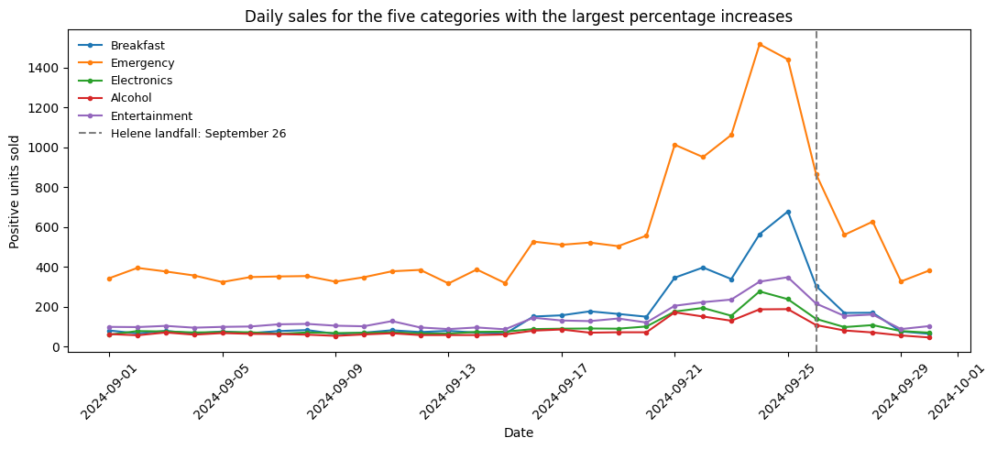
Question 1: Demand Surge Identification
Category | Increase in average daily units
Breakfast | 414.36%
Emergency | 184.25%
Electronics | 150.27%
Alcohol | 125.66%
Entertainment | 124.97%
Caption: The graph shows multiple line charts of daily positive-unit sales for 5 product category with the largest percent increase in sales and an annotation marking the landfall date of Hurricane Helene.
Largest Increase
Percent vs Quantity
Data points
The Breakfast category had the largest percentage increase from the baseline(September 1-15) to comparison(September 19-25) window, where the average daily sales rose from 73.27 to 376.86 units, a 414% increase
Though Emergency had the highest daily volume of any category, at a little over 1 million units sold during the comparison window, Breakfast saw a larger relative growth in purchase volume compared to its baseline window than Emergency did
Our analysis comes from around 24,500 dates, and positive quantity sales records. Duplicates were removed and any non positive quantities were also dropped.
Notes:
Breakfast had the largest percentage increase between our September 1 to 15 baseline and September 19 to 25 comparison window. Average daily sales rose from 73.27 to 376.86 units, or about 5.14 times baseline, a 414.36% increase. Emergency followed at 184.25%, then Electronics at 150.27%, Alcohol at 125.66%, and Entertainment at 124.97%.
Emergency had the highest average daily volume among the five categories plotted, at 1,006.43 units during the comparison window. Breakfast had the strongest relative growth. The daily chart shows purchasing increasing before September 26 landfall.
Our analysis includes 24,521 dated, positive-quantity sales records totaling 47,897 units. We removed exact duplicates and excluded 130 records with nonpositive quantities. Another 881 positive-sale records had no usable date and were excluded from daily analysis. These findings depend on the comparison windows we selected. Q3 examines the relationship between sales and weather.

Slide 10
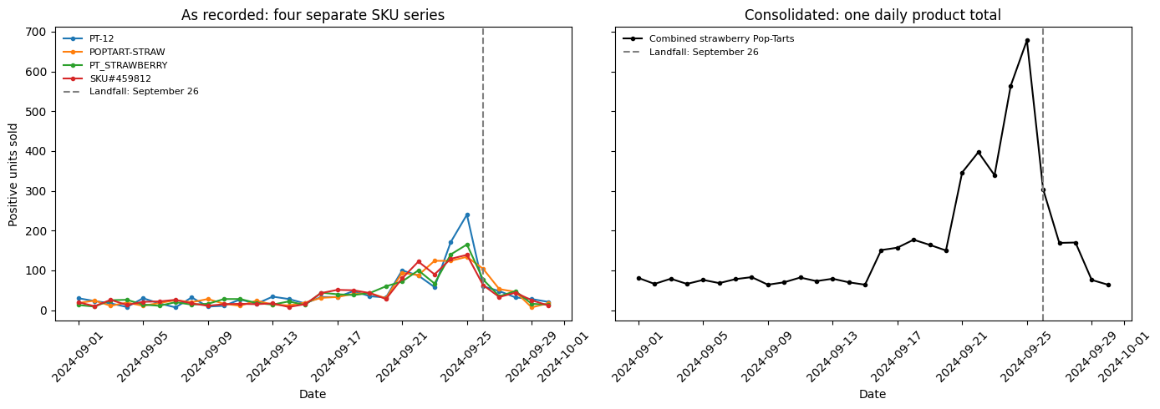
Question 2: The Pop-Tarts Effect (SKU Consolidation)
Caption: Figure 1, the left chart, shows multiple line charts of Pop tart sales numbers under different SKUs. Figure 2, the right chart, shows the sum of all Pop Tart sales for each day, merged into one SKU id.
Merging
Peak
Popularity
Consolidating four strawberry Pop-Tarts identifiers revealed 5,005 recorded units during September.
Combined daily sales peaked at 678 units on September 25, one day before landfall.
Planning from the combined product family gives buyers a fuller demand picture while preserving the original unit total.

Slide 11
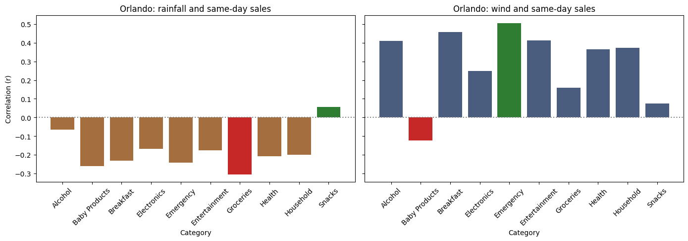
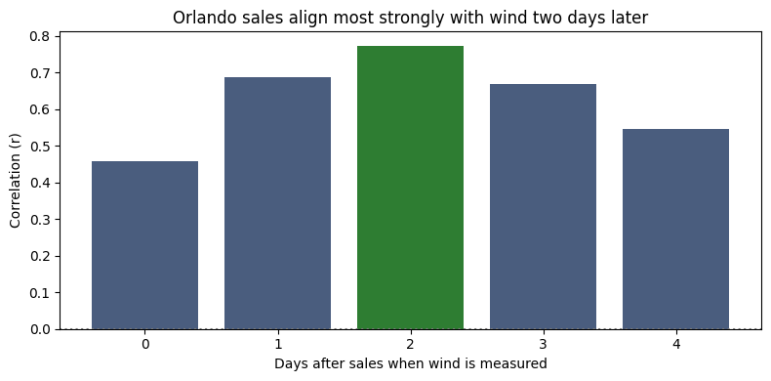
Question 3: Weather Correlation Analysis
Caption: The graph shows a correlation between overall sales data for Orlando and tested the lag from zero to four days while selecting the highest correlation, so the result should be treated as exploratory.
Caption: Figure 1, left chart, displays the correlation between correlation between daily category sales and rainfall measurement. Figure 2, right chart, displays correlation between daily category sales and each weather measurement. There exists a red and green bar demonstrating greatest and lowest correlation for each figure.
Wind correlation
2 Days later
Popularity
Same-day wind correlation: r = 0.458, using 30 paired days.
Sales paired with wind two days later: r = 0.773, using 28 paired days.
Across Orlando categories, Emergency had the strongest same-day wind correlation: r = 0.506, using 30 paired days.

Slide 12
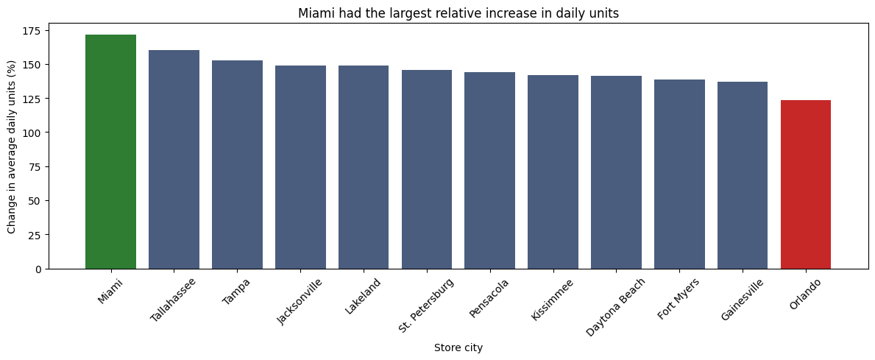
Question 4: Store-Level Geographic Patterns
Caption: The graph represents a bar chart and displays the difference in relative increase in daily units for each store, with a green bar marking the store with the highest relative increase and a red bar marking the lowest relative increase.
Growth
Best Average
Peaks
All 12 stores increased.
Miami had the largest relative increase (171.44%).
Orlando had the smallest (123.42%).
Lakeland had the highest comparison-period average: 239.43 units per day.
Every store reached its monthly peak on September 24 or 25, one or two days before landfall.

Slide 13
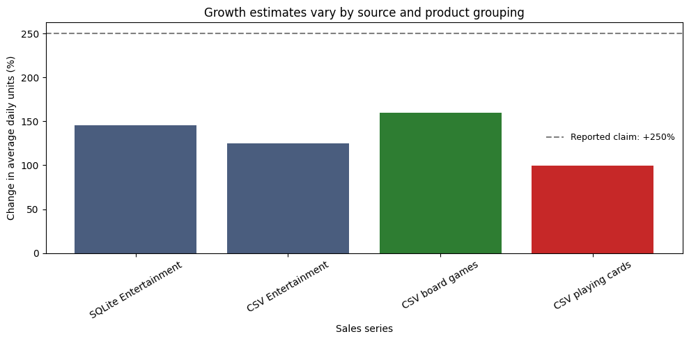
Question 5: Signal vs. Artifact
Caption: The graph represents a bar chart and displays the estimated growth of various products separated into shared categories with the highest expected growth bar marked in green and the lowest expected growth bar marked in red. It also contains an annotation with a horizontal marker of the reported 250% sales increase, which no bar demonstrates.
Sales growth
Disconnect in data
Inventory
Recorded Monopoly sales increased 159.94%. Entertainment also includes playing cards, so category growth does not measure board games alone.
Monthly Entertainment totals disagree: 24,070 units in SQLite versus 4,250 in the cleaned CSV, despite matching all 360 store-days.
Inventory records cover 218 of 360 possible store-days, and 45 records lack order quantities.

Slide 14
03
Reflection

Slide 15
RQ1: Data Quality Impact
Quality Issue
Specific Example
Suppliers were mismatched with products in the Product Catalog
Pop-Tarts were assigned to the supplier Roku
Implications
Solution
Mismatched information would have been sent to distribution centers, causing confusion over what product to stock and from which supplier
Noting which suppliers sell which products in real life and translating that information into a dictionary map that revises the catalog to correctly match supplier with corresponding product
Notes:
One specific data quality issue occurred with the supplier assignments in the Product catalog. The suppliers were mismatched to their associated products, causing inconsistencies in the data that would have assigned a product to the wrong supplier. For example, Roku was matched with one of the Pop Tarts products, when it should have been matched with the streaming stick. Another example was Frito-Lay being matched with an LED flashlight, when it should have been assigned to chips variety pack. This required me to initially use logic rather than data cleaning and do some quick external checks to correctly match each product with its corresponding supplier. Then, once I had a good sense for accurate product and supplier pairings, I created a Product to Supplier dictionary map within Colab to facilitate correct assignments. For example, ‘Pop-Tarts Strawberry’ : “Kellogg’s”, correctly matched the Pop-Tarts to the Kellogg brand. What would have happened had I not corrected this is that the distribution centers would have been relying on suppliers that don’t sell the product they were initially assigned to, creating the potential for mix-ups in what products to supply to meet the hurricane demand.

Slide 16
RQ2: ETL Trade-offs
Keeping stores
Dataset-specific rules
We manually supplied missing location details and selected local weather timezones to retain affected stores.
Store-specific rules and a distribution-center lookup dictionary supported weather retrieval for the supplied dataset.
Easier maintenance
Alternative approach
A separate location-cleaning function would make the pipeline easier to maintain as new locations are added.
Dropping incomplete stores would simplify retrieval but exclude their sales from weather comparisons, potentially changing the findings.
Notes:
Missing timezones, and coordinates were handled using a function that directly added the relevant data directly to the csv. Conditions were made for if a city was outside of the Eastern time zone so that it would be registered as central instead. For the distribution centers, a dictionary was added in the function that generated weather data for them rather than another separate function to clean the centers.
An alternative approach would be to have a new function to clean the distribution centers, this could be a more future proof option but due to my current skills level and quality of the data it is difficult to account for all situations outside of this one. Another approach could have been to simply drop the store data that did not have the applicable data for data collection, but this would have rendered all the weather data for that store and it’s transactions unusable because it would be impossible to see the weather statistics for that store and the purchase trends over time as the weather worsened.

Slide 17
RQ3: Pipeline Trust
Reliable inputs
Manual location data
Pipeline errors can undermine an otherwise correct analysis.
Weather retrieval relied on supplied coordinates and location-specific timezone rules.
Consistent join keys
Validation checks
Store IDs and dates needed consistent formatting to match sales with weather.
We excluded undated sales before daily analysis and checked that the join preserved eligible rows and unit totals.
Notes:
I agree that the pipeline was the biggest risk. Misclassifying the products through discrepancies between SKU, product name, and supplier would have caused inconsistent information to be sent to distribution centers. That would have caused confusion over whether the supplier, the SKU, or the product name was the accurate information to follow. This would have led to challenges to meet consumer demands during a natural disaster event.
Where I believe our data pipeline is most fragile is that it only gives product information for 23 product types (after consolidation), even though Walmart sells thousands of different products. This means that there are potentially products that Walmart sells that are in high demand during a hurricane that the product catalog doesn’t address.
Additionally, the weather generation is fragile as it is tailored to this specific model and dataset. I do not know of any way to generate location and timezone data based on city name alone, which makes this fragile if any other stores are added without proper documentation of their geographical location and timezones. The weather joining is also fragile because it depends on store ids and timestamps being present that can be overlapped, so if any timestamp data is missing then those rows will be dropped by the pipeline, losing that data.

Slide 18
RQ4: Business vs. Data
Sales increase
Conflicting data
Board game sales increased 160%, supporting consideration of extra stock before future events.
Conflicting sales totals and incomplete inventory records limited confidence
Real risks
Recommendations
Balancing excess inventory against missed sales and reduced product availability
Check each store’s stock and open orders before replenishing. With more time, we would reconcile both sales sources and compare more historical data.
Notes:
For question 5, we definitely had incomplete data. Our board games, playing cards, and the entertainment category as a whole saw sales rise by 160%, 99%, and 145%, respectively. The transaction data and the database, however, showed gaps between their respective datasets. These gaps made the risk of over-ordering products based on faulty data very real. However, there was an alternative risk of ordering too little. These two issues present very different risks: one for Walmart's business health, and the other very real risks to customers in the middle of a hurricane. Our recommendation was based on the need to check each store’s current stock and ordered shipments, and to send extra products, such as board games, where necessary.
With more time, I believe it would be prudent to compare sales data more carefully. With better data, I would check whether these increases in sales happened during other events and whether both sources of sales data agree. If these increases held up, I would be more confident in recommending extra stock to stores.

Slide 19
RQ5: Team Collaboration
Mark
Michael
Mark asked useful questions, persevered through join issues, and completed the API calls and joins.
Michael carefully cleaned the data, standardized SKUs, and tracked records to preserve rows and build a reliable foundation for analysis.
J.S.
Teamwork & Next Steps
JS provided leadership, programming guidance, and initiative, while keeping the project on schedule and helping shape the presentation.
We divided responsibilities, met regularly, and helped each other solve problems. With another week, we’d improve reuse and automate store-location lookups.
Notes:
Mark:
We divided the work so that each person had a hand in someone else’s task in a way except for data cleaning. We separated all the tasks by the skills necessary to complete them, so that sqlite, weather api and joining, and weather cleaning were three separated tasks that our group of three could divide evenly. If we had another week I would have looked into more future proofing methods and maybe a method of finding locating geographical store locations automatically instead of having to add them manually for the specific store.
JS- contributed excellent leadership skills and involvement to maintain team contact. He also contributed his experience in computer and data science as a whole to be a reference for us as well as use it to our advantage by taking initiative and coding.
Michael-Contributed his perseverance, dedication, and attention to detail in cleaning the data rigorously. He reordered all the product suppliers in a way that makes sense without dropping any rows, canonized the skus so that they are readable and applicable to the transaction data. He worked with lots of data and kept track of all of it so that nothing was missing after it got cleaned.
JS:
I believe we worked somewhat effectively as a team, there was consistent weekly meetings we had throughout the midterm project, sometimes multiple times a week when necessary. We would communicate quite frequently to help eachother out whenever there were certain issues or roadblocks someone faced, such as when Michael had an issue with how we was supposed to ingest and process the SQLite dataset. Mark and I provided our thoughts and knowledge on how to process it and we worked out best steps to move forward. There was still an importance on having responsibility for your specific work as I believe it allowed everyone to confirm, practice, and grow their skills throughout this midterm project.
Mark - Provided great questions that helped us think about how we should approach this project. Also contributed his knowledge of programming to ensure that people were able to approach any problems in the correct way. All of his joins and API calls worked perfectly on first try and helped us work on other necessary parts of the project sooner than expected.
Michael - Worked extremely hard on his data cleaning aspect. This was the aspect we were worried most about and encountered issues with as it involved steps that we would be approaching for the first time and we would not notice issues with this until it was too late in the project. Michael took responsibility for what was arguably the most important section and thoroughly went through every single aspect of data cleaning to ensure that we had good work to build our joins, analysis, and charts off of.
Michael:
I think we did a good job of initially establishing roles and delegating responsibility evenly. Since JS is more knowledgeable and experienced in data analytics and visualization, he was a helpful resource throughout. I was transparent that this was my first real data science course, and both Mark and JS were willing to confirm my work and responded promptly on problem-solving techniques when I ran into problems. Mark displayed great perseverance, and was successfully able to execute joins even when they initially didn’t work. He provided a good example of how to wrangle with problems and diagnose the root cause. JS did a great job of essentially leading the progression of the project and ensuring we were on time. He also did a very effective job of helping us curate a presentation that effectively showcases our process and results. The visualizations that were created were effective at telling the story of our findings, and I was able to learn from both Mark and JS as someone who hasn’t yet taken a data visualization course myself. I think we all did a good job of responding promptly to ensure we stayed on task, and we were able to get everything done on a time, which I think is a testament to our time management. Overall, I think I extracted a lot of value from this project and can now apply my data cleaning skills to more projects and professional experiences.

Slide 20
Thanks
Questions?
Please keep this slide for attribution

